Slide 1




Enabling Part-Process Design for Metal Additive Manufacturing
NASA Space Grant Symposium 2022
Raphaelle Guinanao
Mentor: Dr. Hannah Budinoff
MADE Lab: Jannatul Bushra, Carlos Robles, David Manford

Slide 2
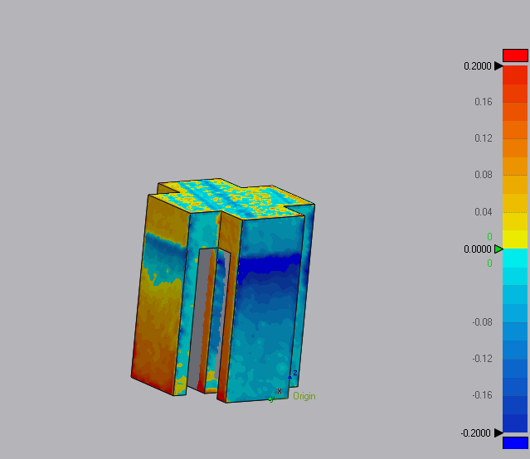
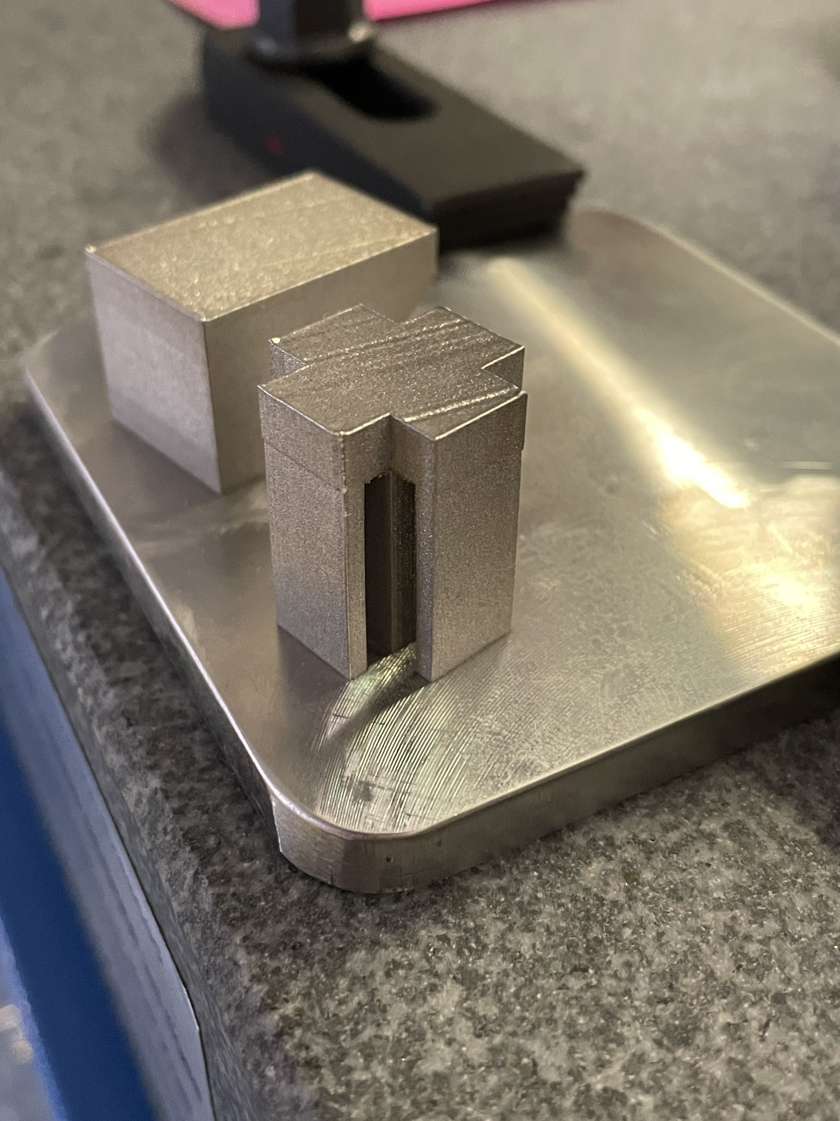
Background to Additive Manufacturing
Additive Manufacturing (AM)/ 3D Printing
  Allows for the fabrication of detailed parts
  Grown in popularity and ease of access
Process parameters
  Variables affecting printing process

Slide 3
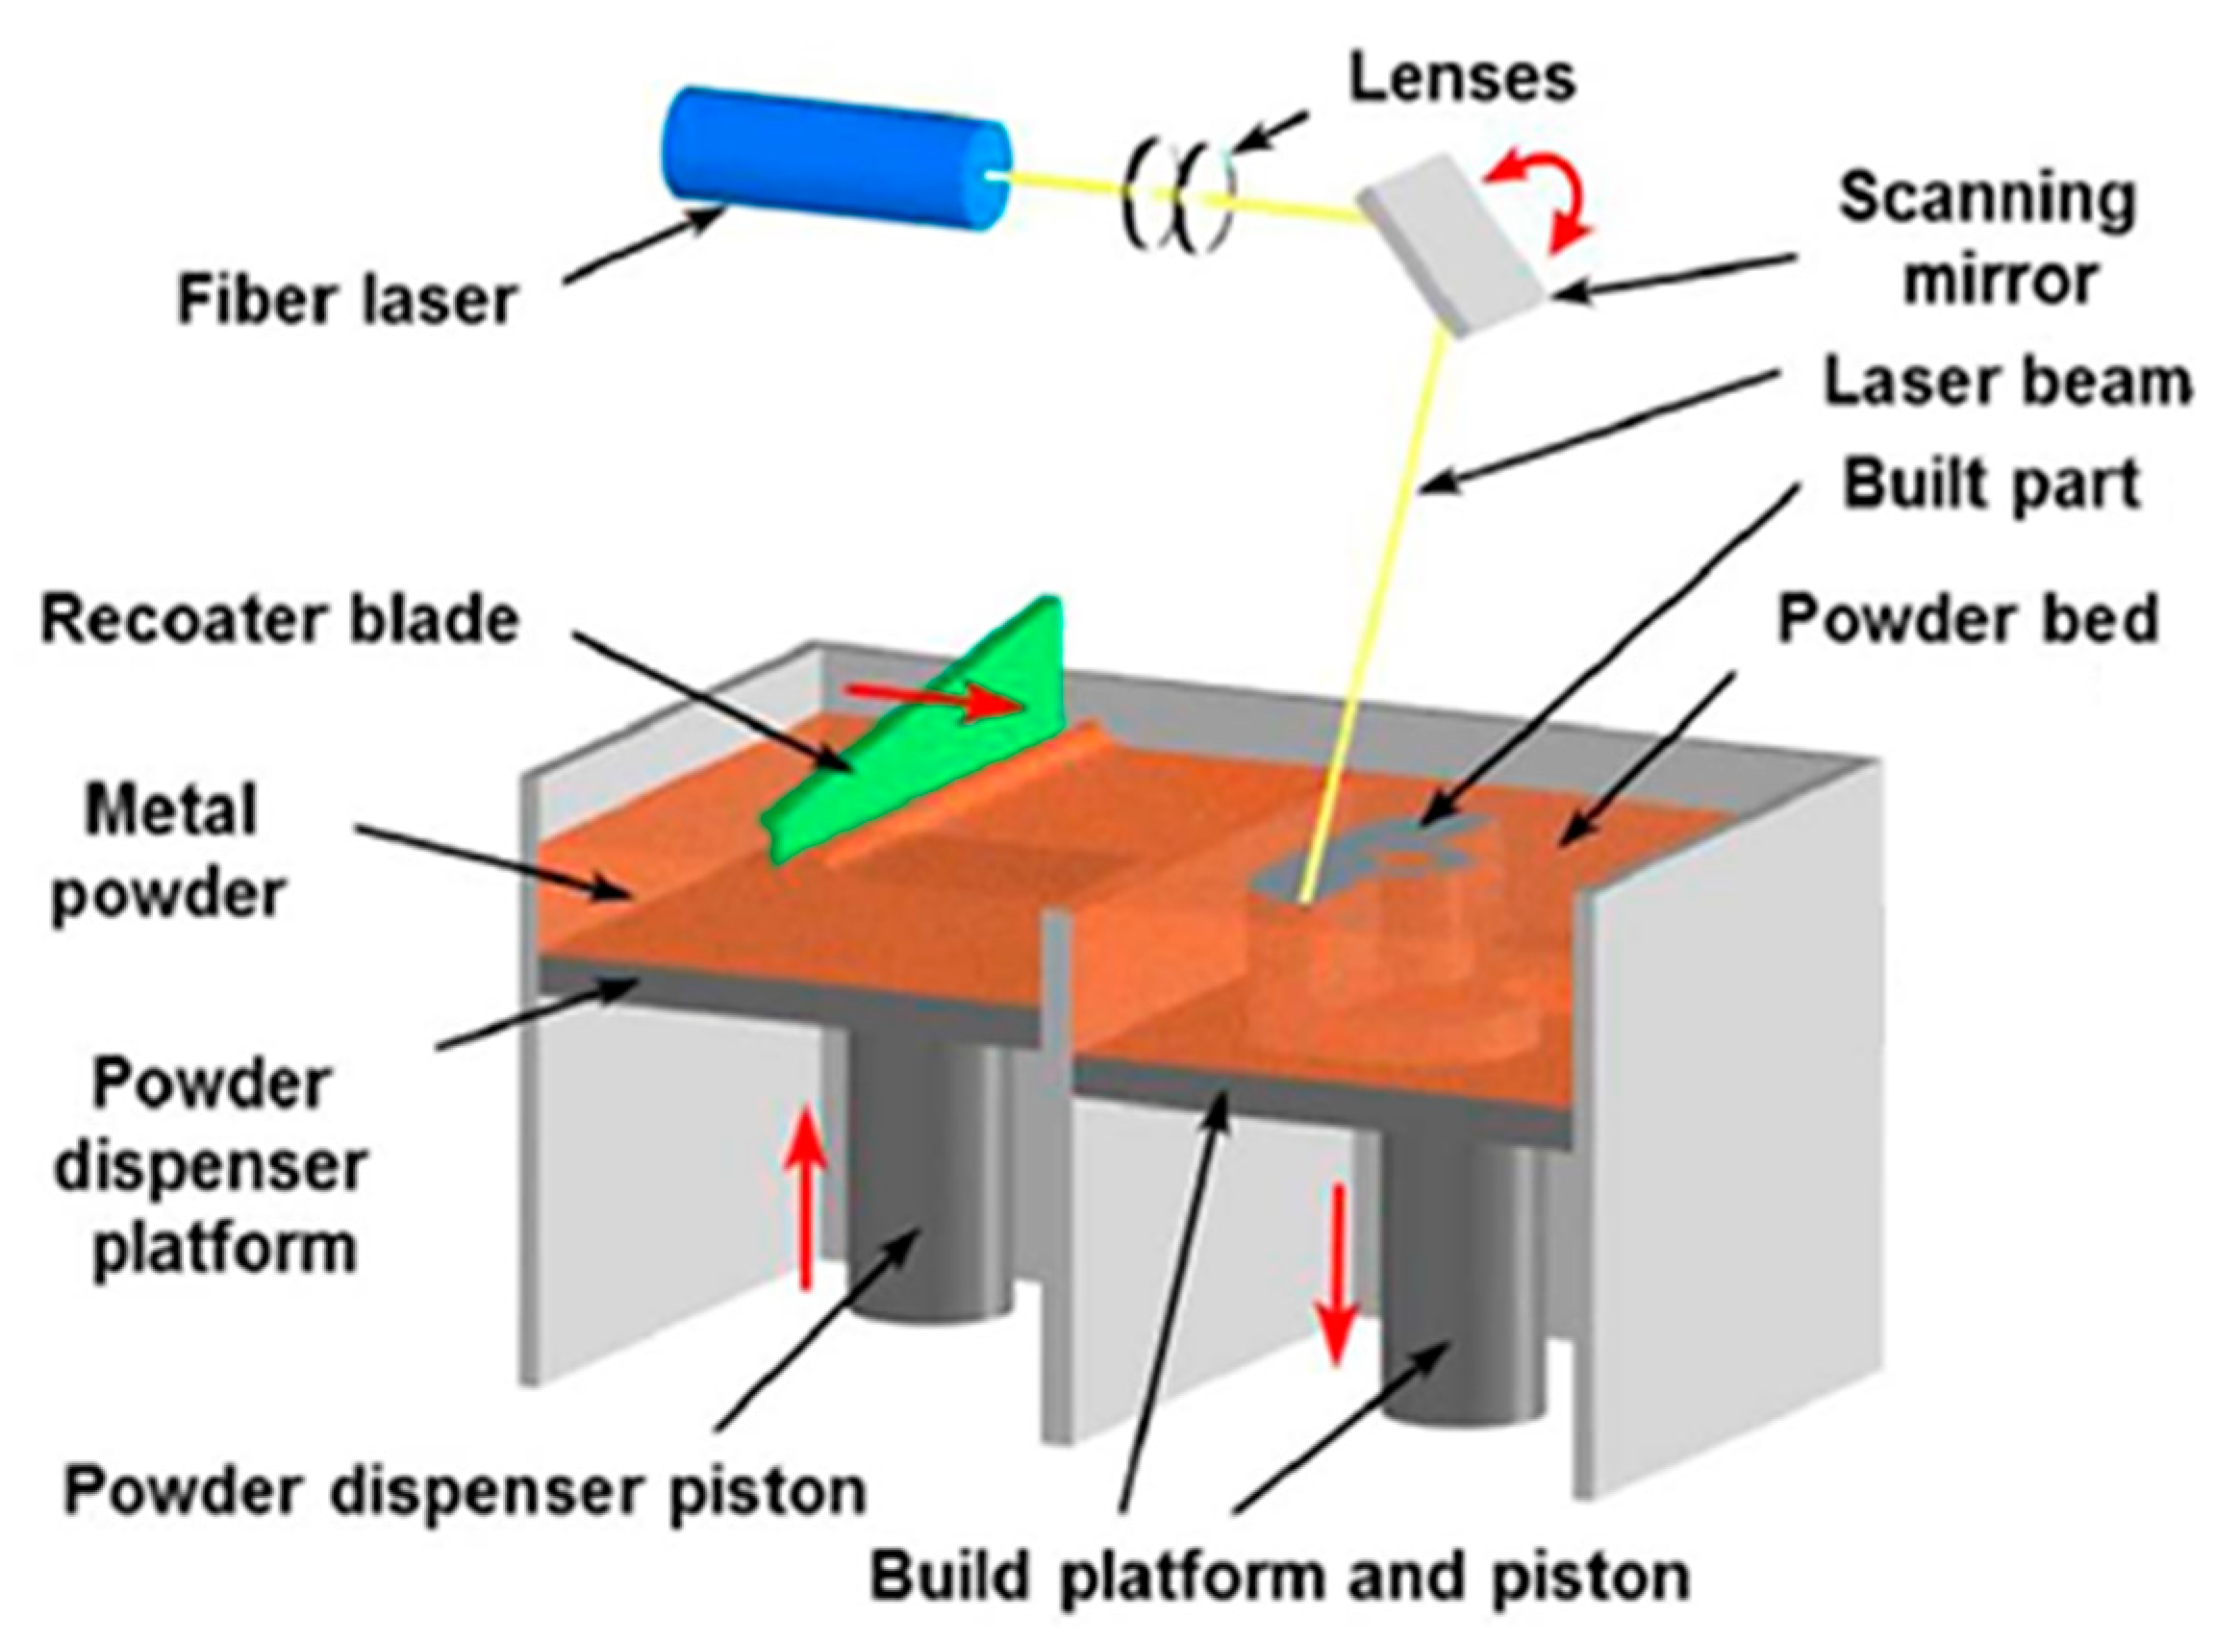
Background
Powder Bed Fusion (PBF)
  AM Process employing metal powder
ANSYS Additive
  Software which allows us to simulate the PBF process on given parts
  Running thermal strain simulations
Source: Material Reuse in Laser Powder Bed Fusion: Side Effects of the Laser—Metal Powder Interaction

Slide 4
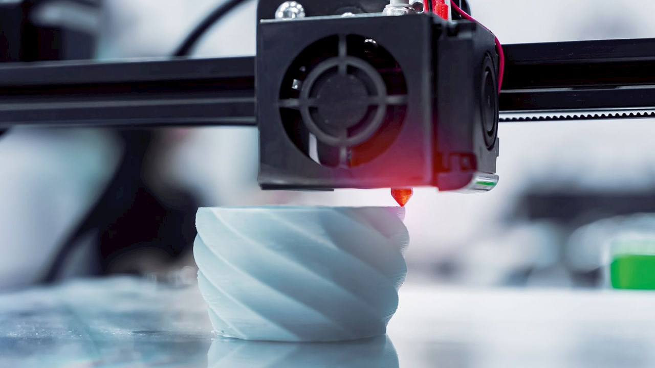
How sensitive is part distortion to geometric and process parameter variation?

Slide 5
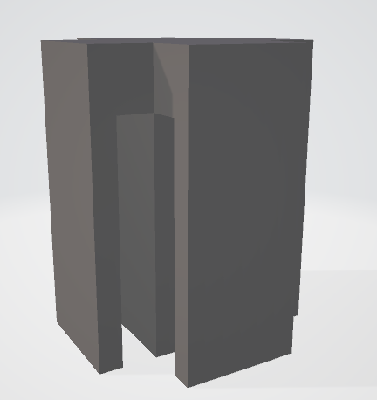
Experimental Design
Calibrate Simulations
Prepare geometrical parts
Run simulations of combinations of different parts and process parameters
Examine and analyze results
Web Width
Roof Height

Slide 6
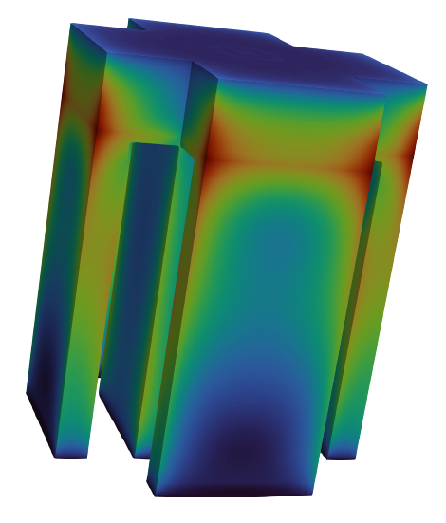
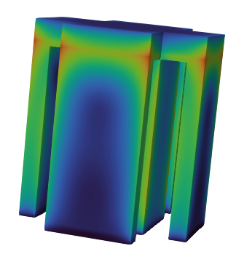
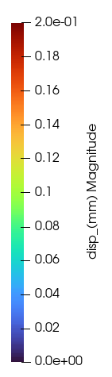
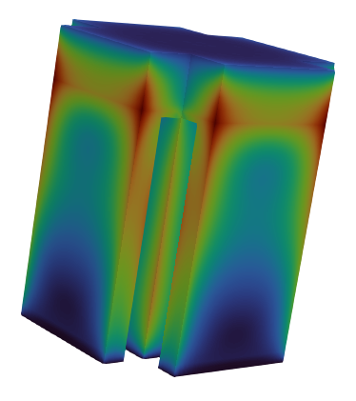
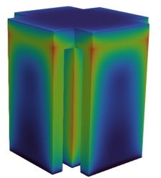
Analysis
PART GEOMETRY (in mm)
Roof Height (mm) | Web Width (mm) | Scan Speed
5 | 10 | 900
5 | 10 | 1200
5 | 10 | 1500
3 | 10 | 900
3 | 10 | 1200
3 | 10 | 1500
5 | 12 | 900
5 | 12 | 1200
5 | 12 | 1500
3 | 12 | 900
3 | 12 | 1200
3 | 12 | 1500
Roof Height (5mm)
Web Width (10mm)
Roof Height (3mm)
Web Width (10mm)
Roof Height (5mm)
Web Width (12mm)
Roof Height (3mm)
Web Width (12mm)

Slide 7
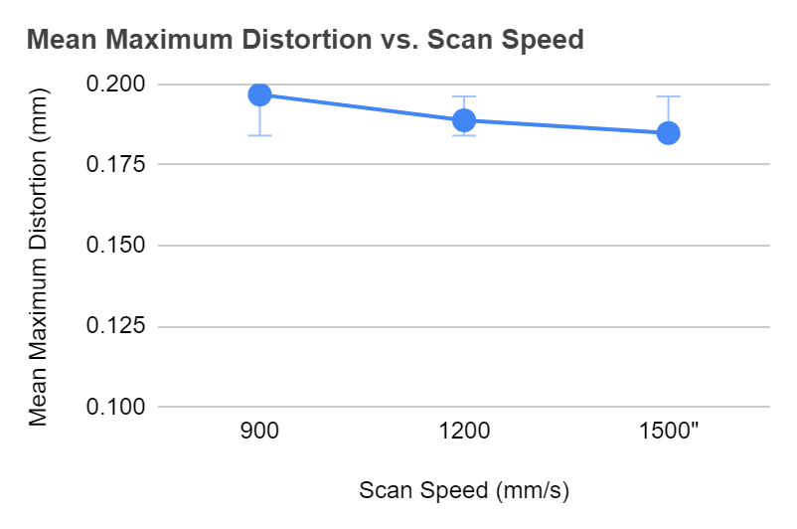
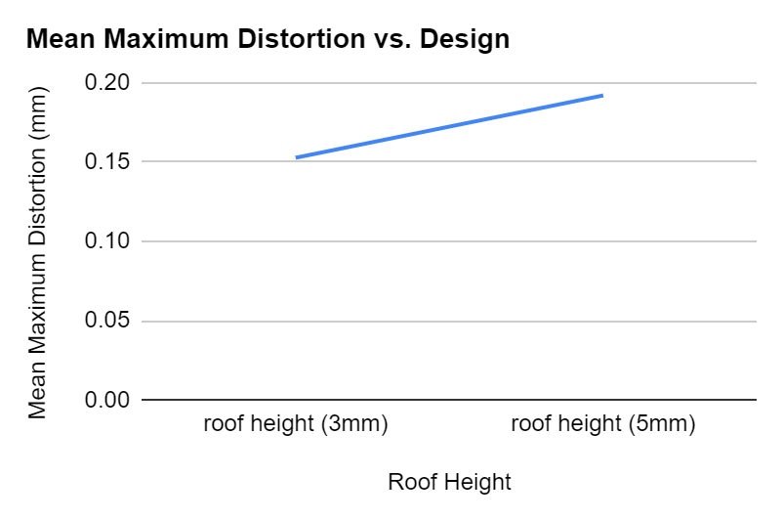
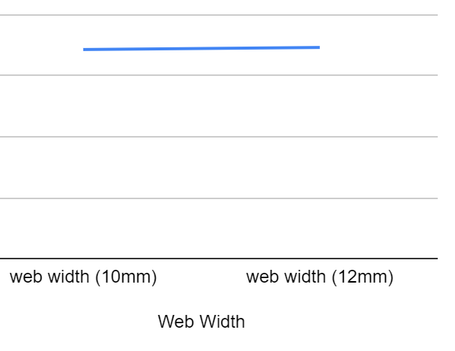
Analysis

Slide 8
Conclusion
Significance
  Inform engineers employing PBF processes
  Allows us to predict/ optimize the accuracy of parts based on process parameters
Future iterations
  Current results are only a small sample size of the current experiment. Still have 4 more geometrical parts.
  Explore effects of different process parameters
  Apply results to machine learning models to predict part accuracy

Slide 9


Thank you!
Acknowledgements:
MADE Lab
Department of Systems and Industrial Engineering

